Slide 1
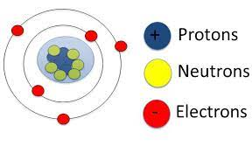
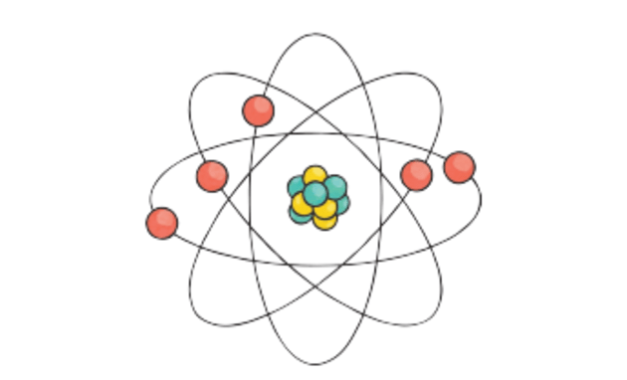
Atomic structure
Matter is built up from small discrete particles called atoms.
An atom is made up of three basic particles; …………..…….….., ………………….….. and …………………..…. .These particles are called ………………………. particles.
The …………………… and ……….……………. are found in the nucleus of the atom. These two particles that make up the nucleus are known as nucleon.
The electrons move around the nucleus in exact ………

Slide 2
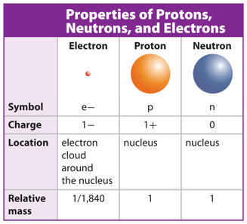
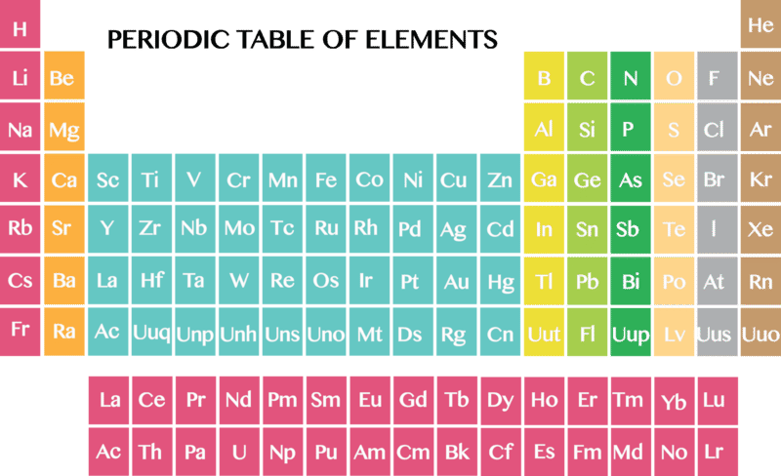
Atomic number = number of proton = number of electron
(proton number)
Mass number = proton + neutron
(nucleon number)
Neutron = Mass number - atomic number

Slide 3
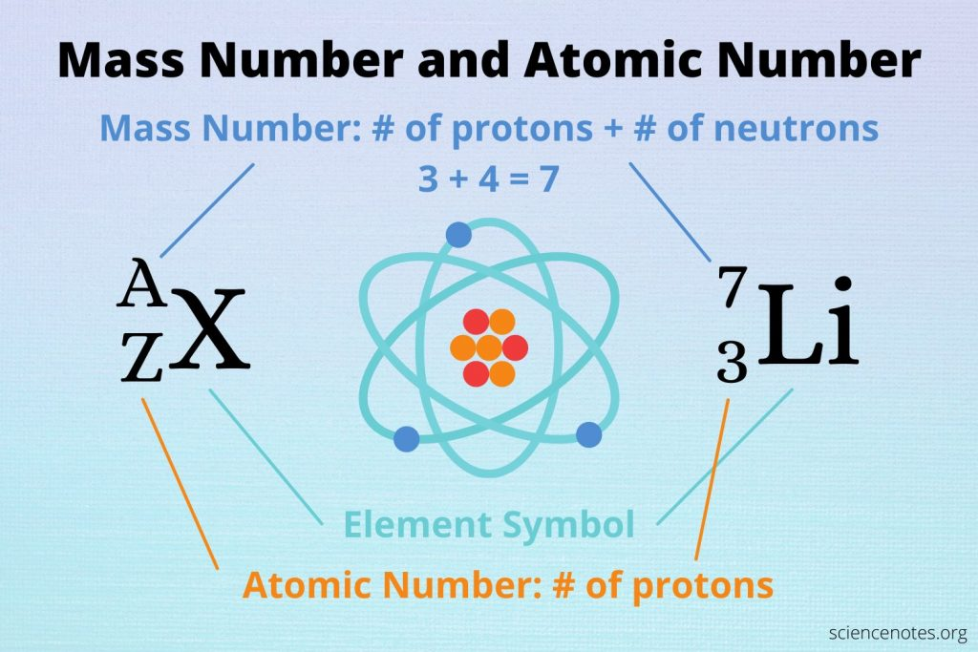

Slide 4
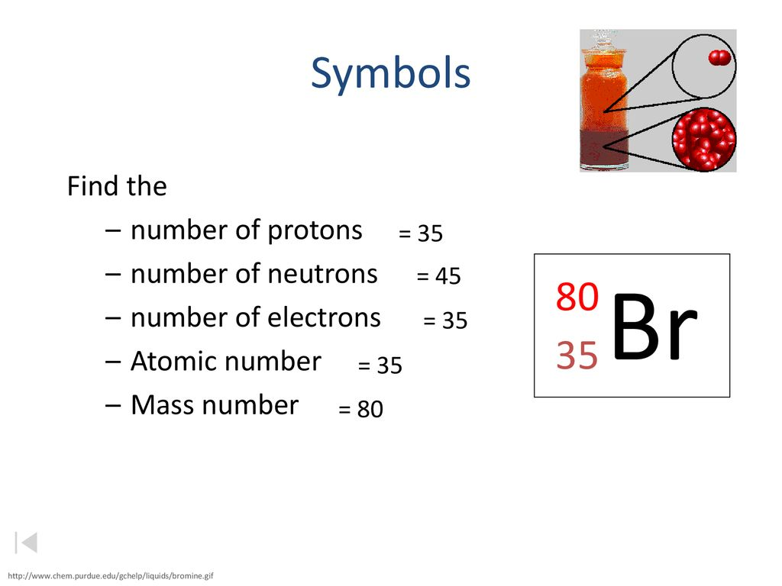
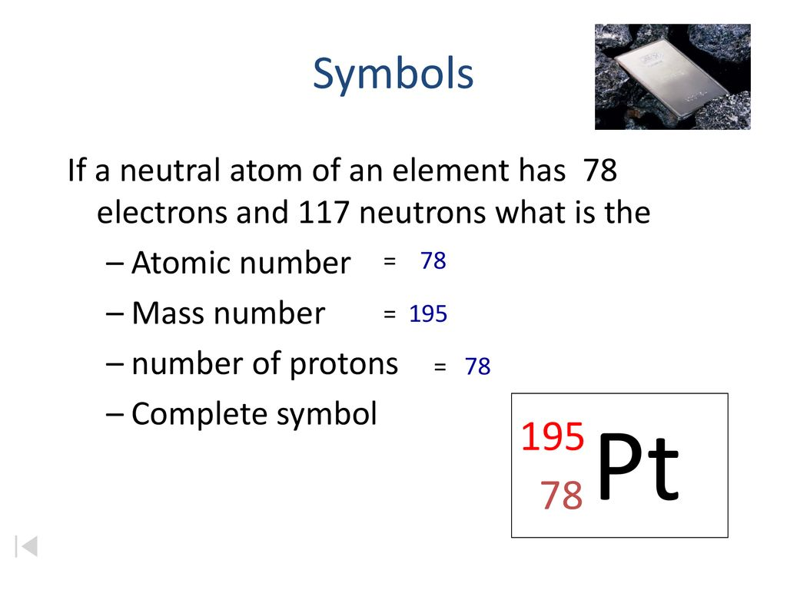
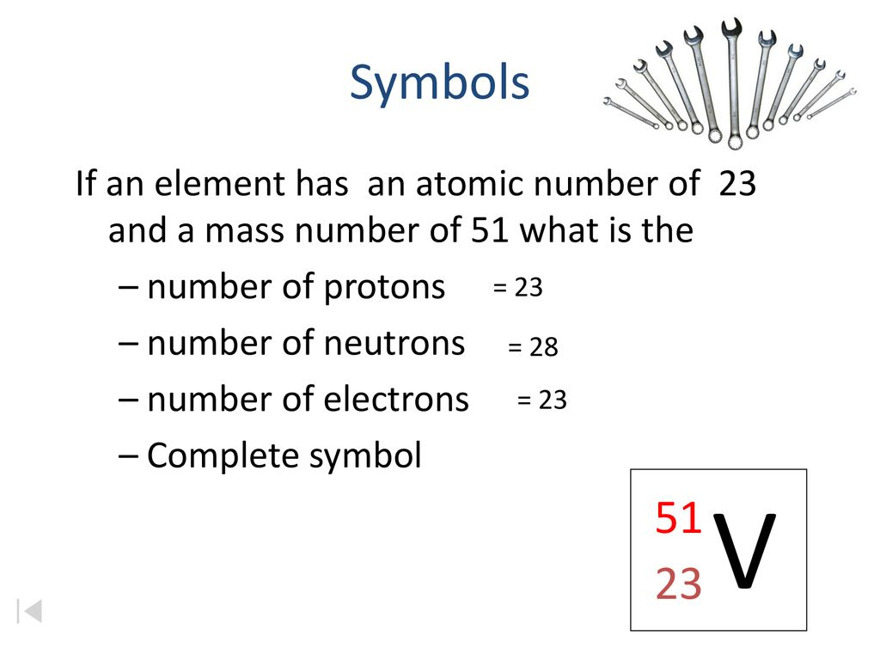

Slide 5
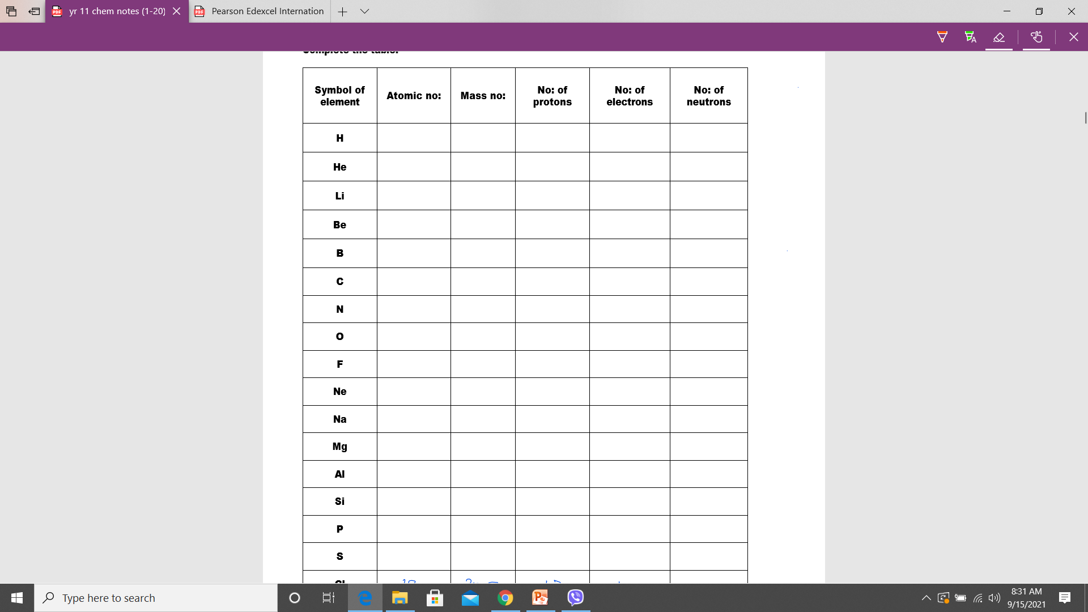

Slide 6
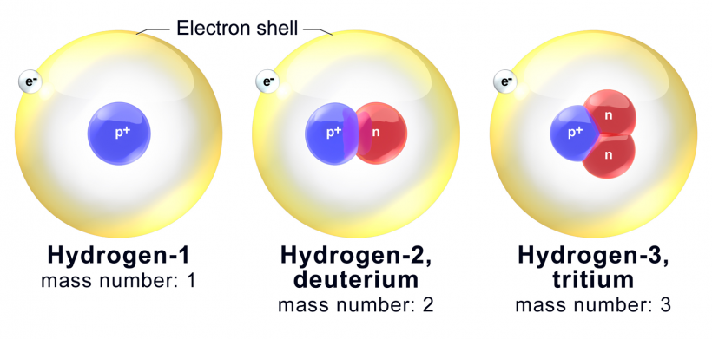
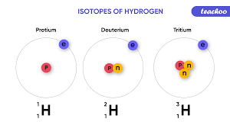
Isotopes

Slide 7
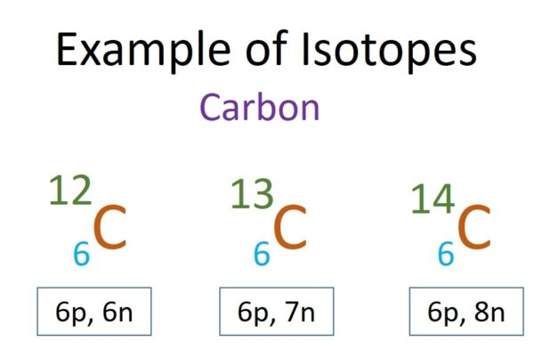
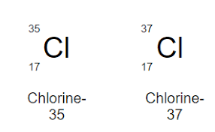
Isotopes
Isotopes are the atoms of the same elements with same atomic number but with different mass number.
Isotopes are the atoms of the same elements with same number of protons but with different number of neutrons.
Their physical properties are different because of different numbers of neutrons.
( mass ,color , density , mpt and bpt )
Their chemical properties are the same because they have same number of valent electrons and same electronic structure.

Slide 8
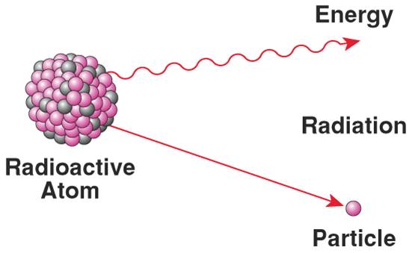

Radioactive isotopes
Some isotopes have the unstable nuclei that emit radiation after time to time to be stable.
Uses
Medical uses
1. cancer treatment
2. Goiter treatment
3. Sterilization of medical equipments
4. Medical diagnosis
Other uses
Carbon dating to find age of fossils
Checking paper thickness and gas pipeline leakage
Generating electricity in nuclear power station

Slide 9
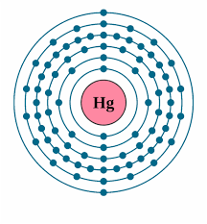
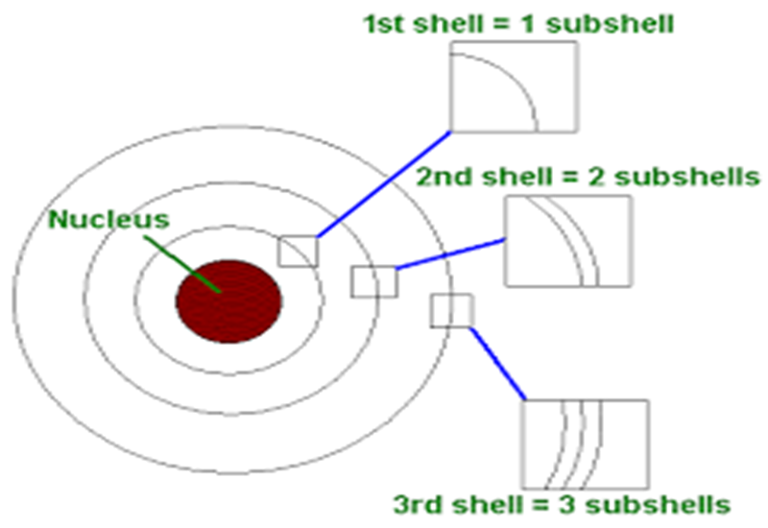
Electronic structures
The electrons move in the shells or orbits or energy level.
The maximum number of electrons in each shell = 2n2
Shells can be divided into subshell.

Slide 10
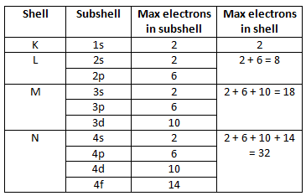

Slide 11
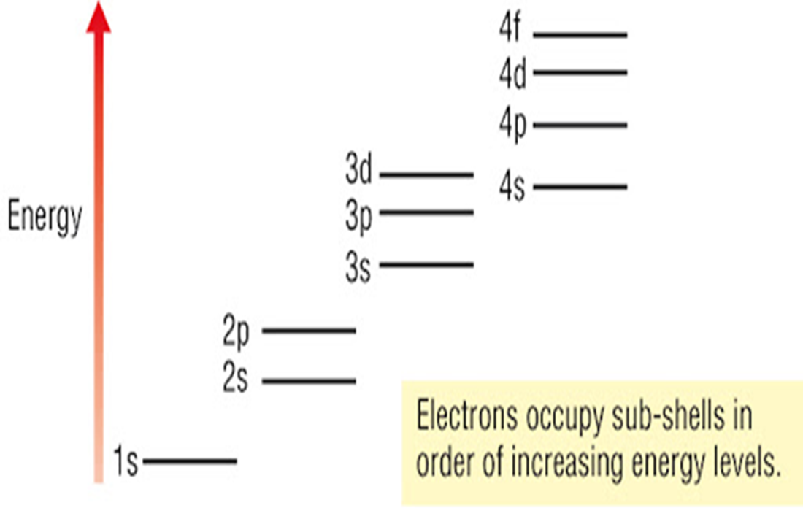
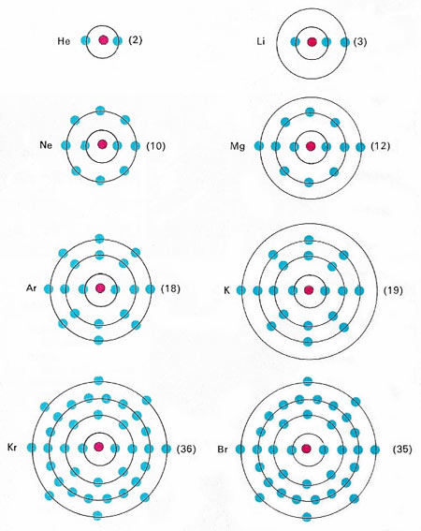
Energy levels

Slide 12
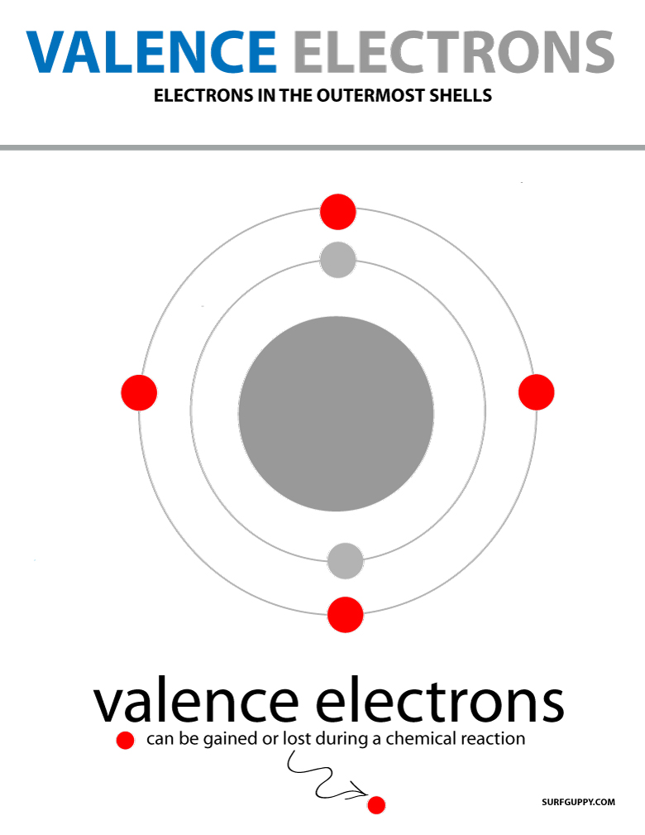
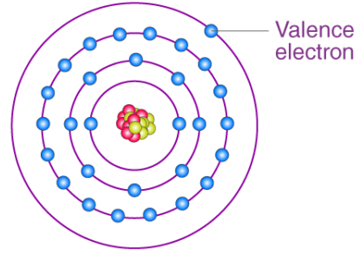
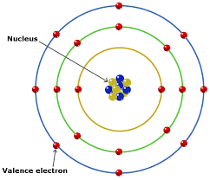
Electrons in the outermost shell are called valent electrons that are used to form chemical bonds.
Metals have less outer electrons – 1, 2 or 3 electrons.
Non-metals have more outer electrons. 4-7 electrons
Group number = number of valent electrons
Period number = number of shells

Slide 13
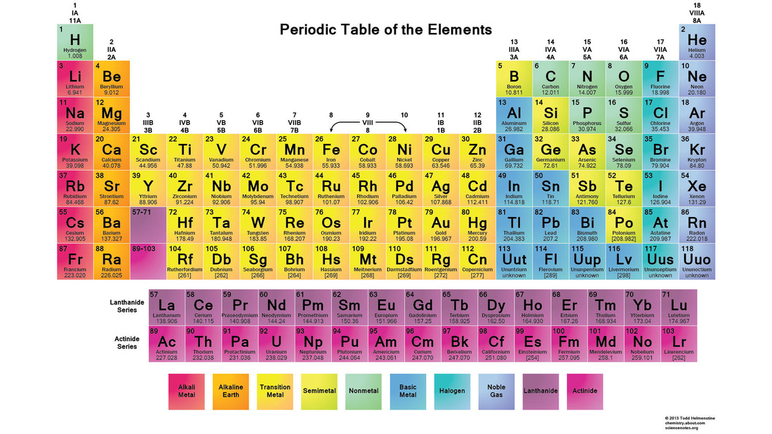

Slide 14
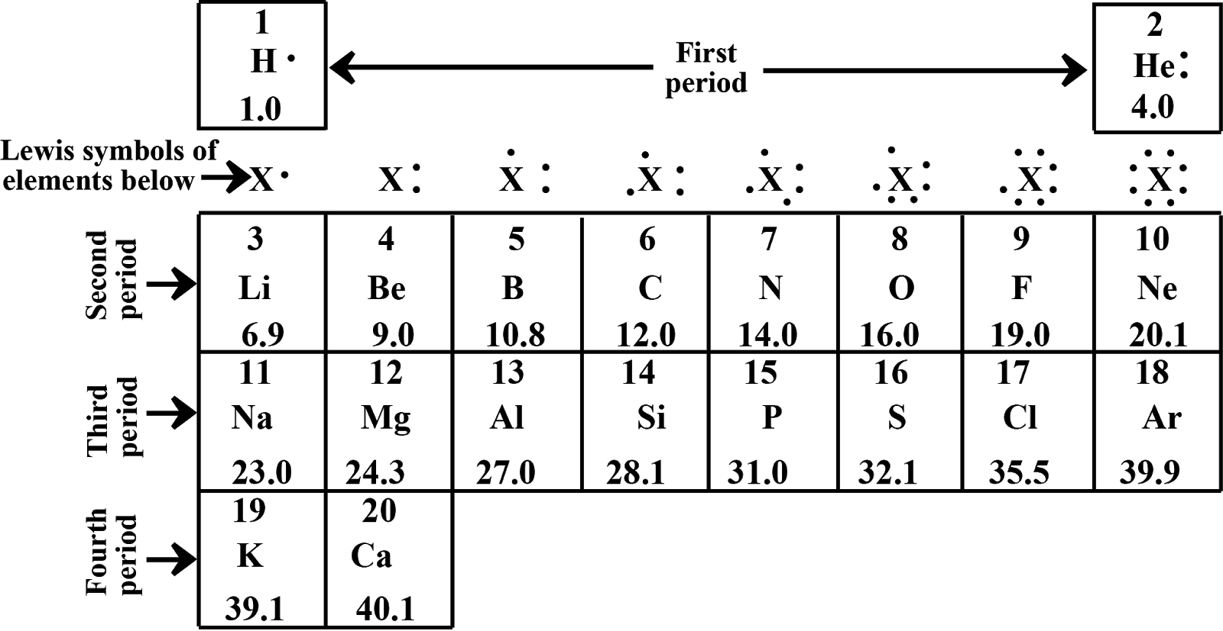

Slide 15
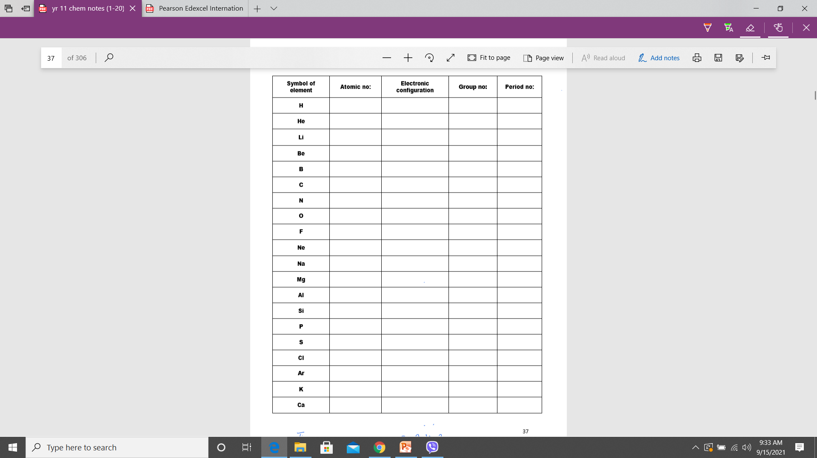

Slide 16
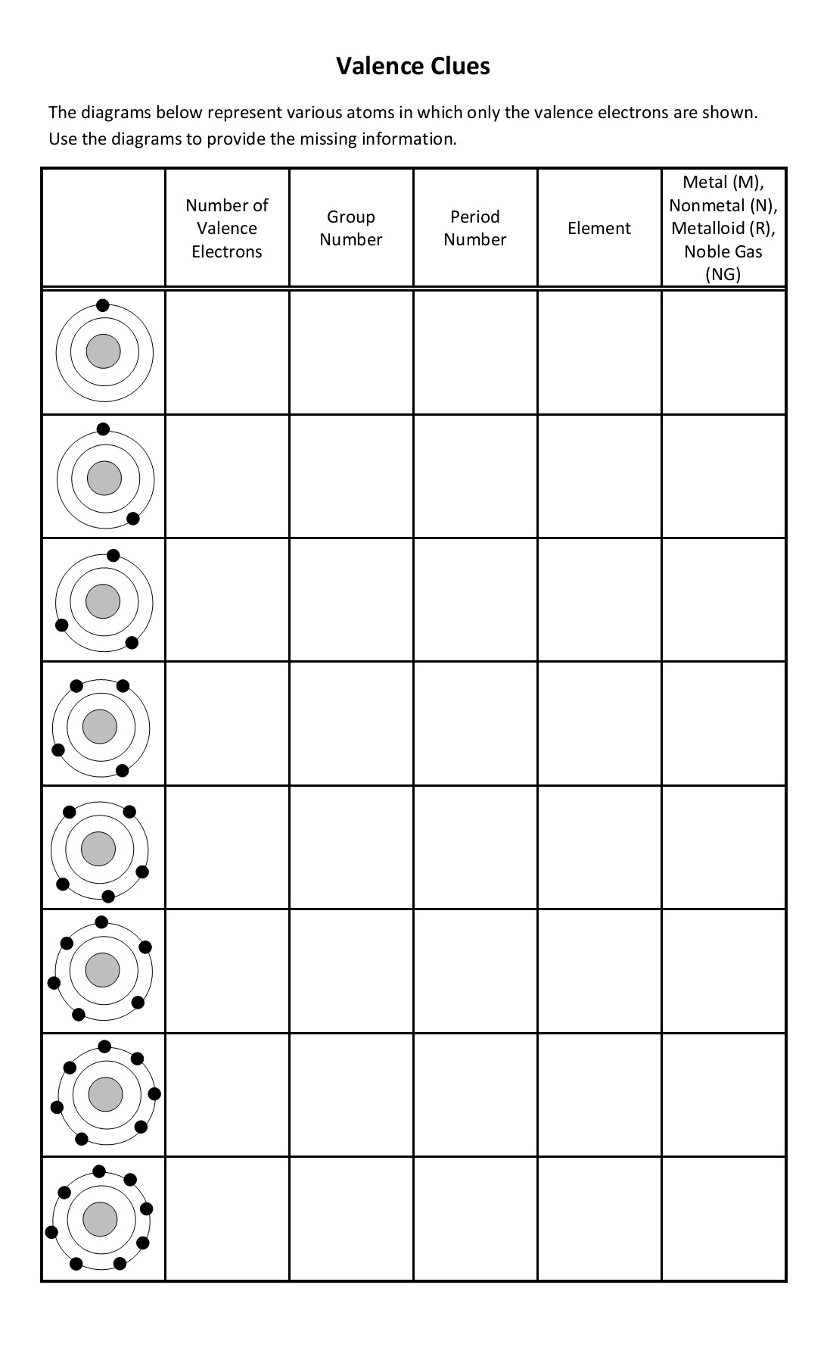

Slide 17

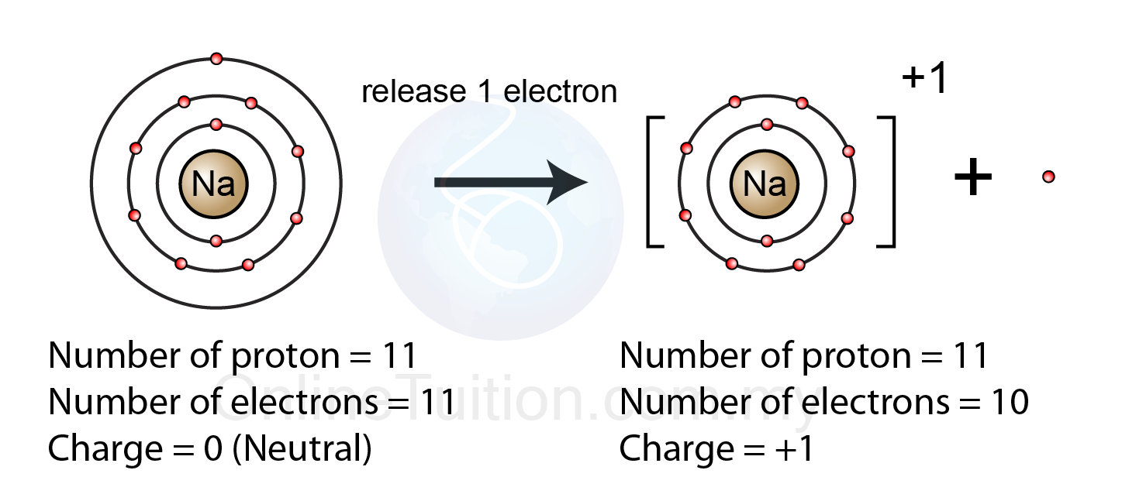
Atoms to ions
Metals atom tend to lose their valent electrons to have stable electronic structure like noble gases.
So after losing their valent electrons, they become positive ions.(cations)
In cations, the number of protons is more than the number of electrons.
Eg. Na (2.8.1) Na+ (2.8) sodium ions
Mg ( ) magnesium ions
Al ( ) aluminium ions
K ( ) potassium ions
Ca ( ) calcium ions

Slide 18
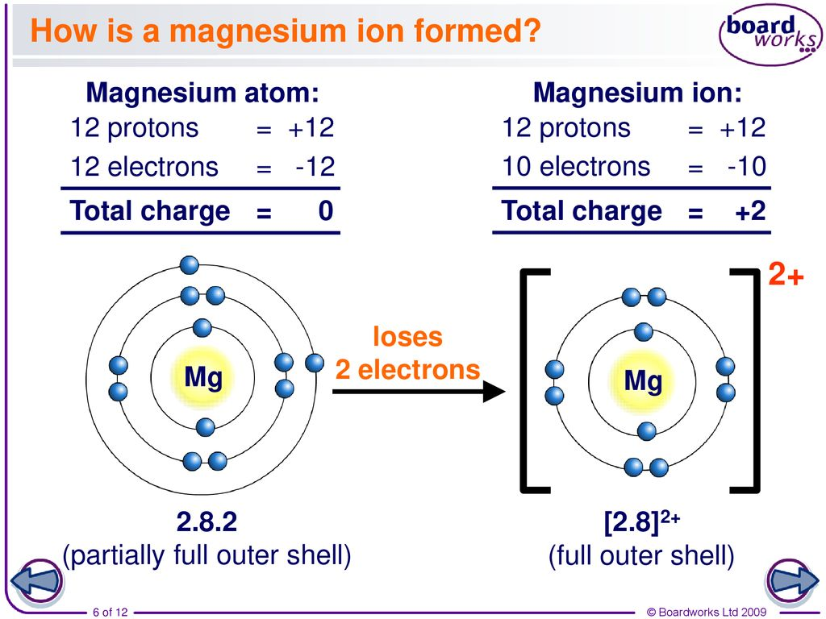

Slide 19

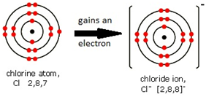
Non- metal atoms tend to gain valent electrons of metal to have stable electronic structure of noble gas.
After gaining electrons, they become negative ions (anions).
In anions, the number of protons is less than the number of electrons.
Eg. O (2.6) O2- (2.8) oxide ion
S ( ) sulfide ions
P ( ) phosphide ions
N ( ) nitride ions
Cl ( ) chloride ions

Slide 20
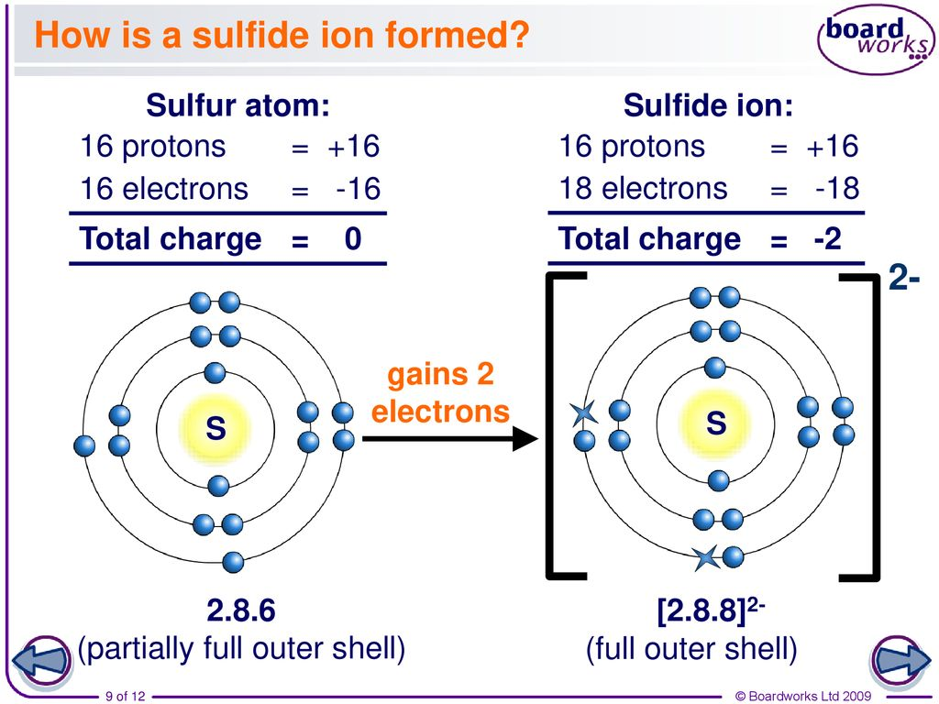

Slide 21
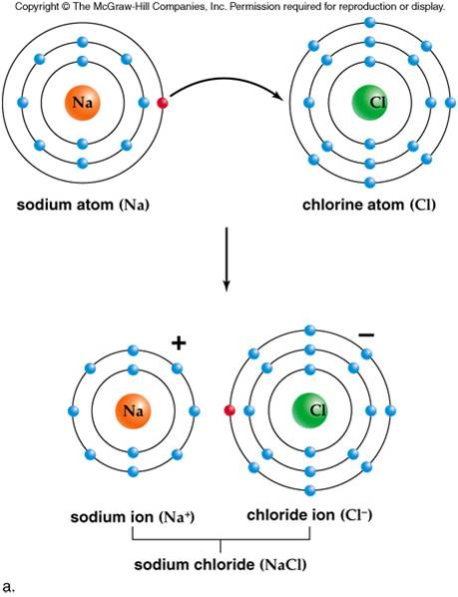
How sodium chloride formed
Ionic bond is formed between cations and anions.

Slide 22
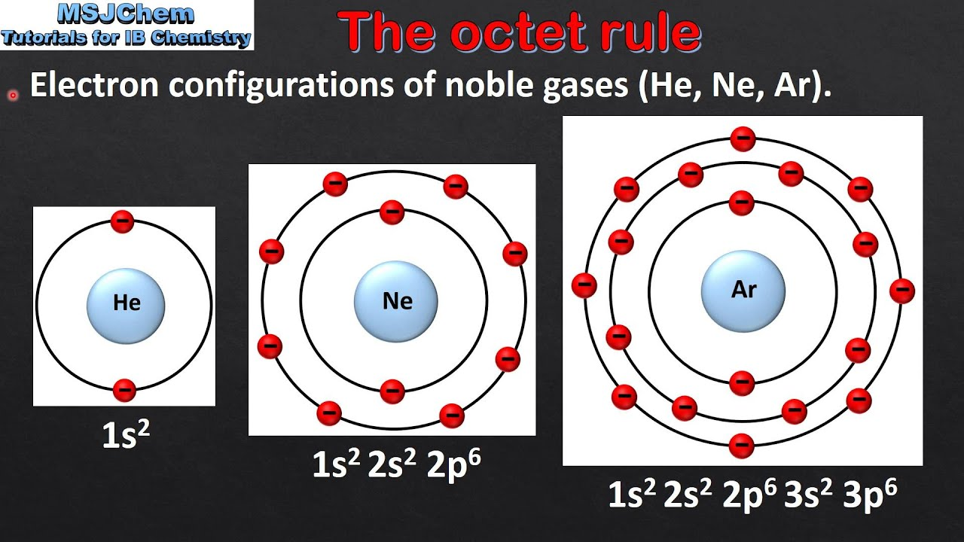

Slide 23

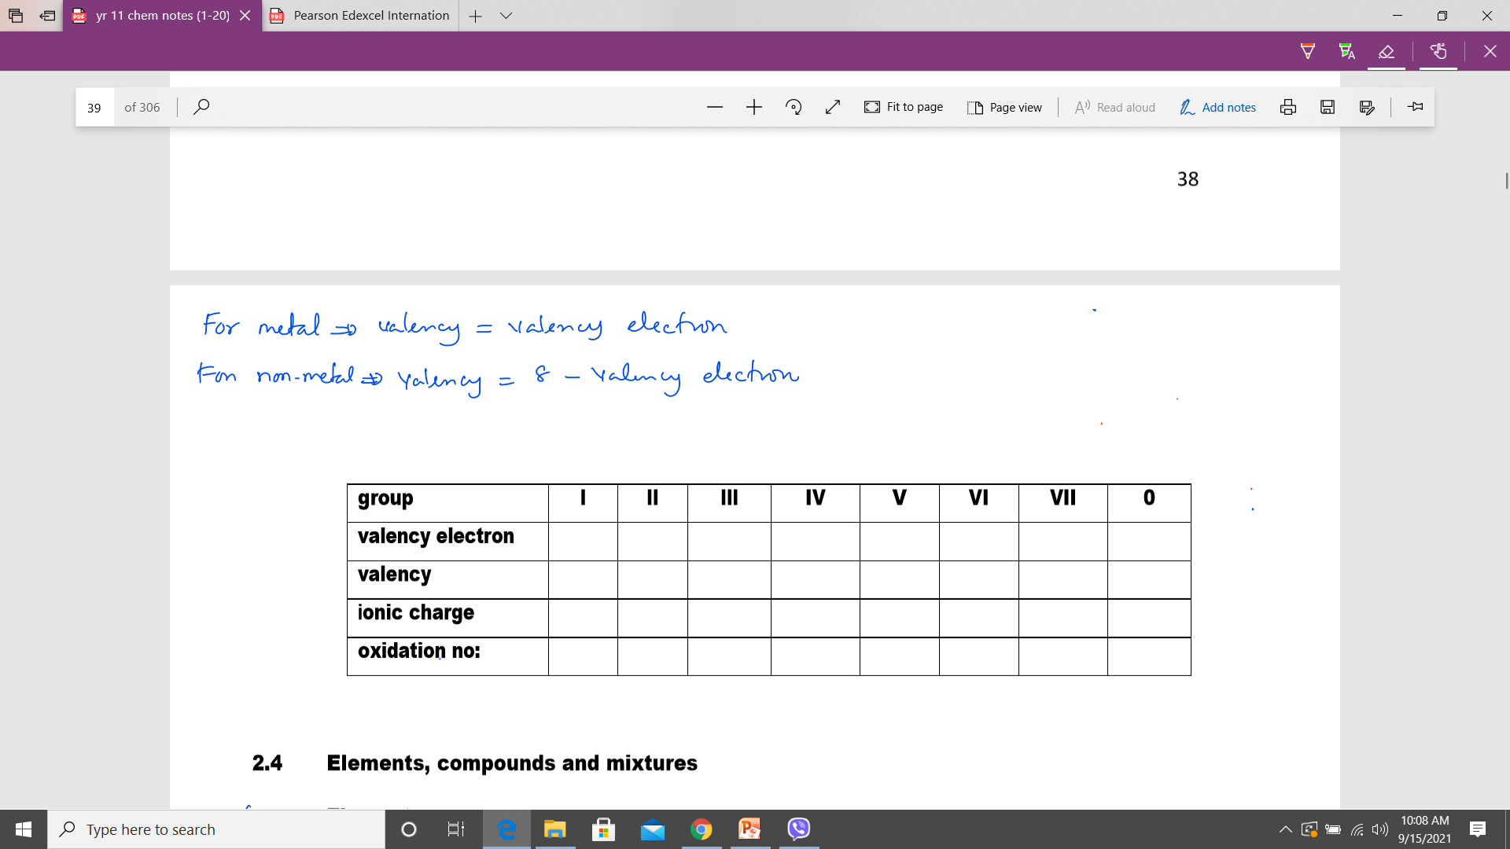
Valency of an atom
It indicate the number of electrons transferred.(lose or gain electrons)
Metal valency = valent electrons
Non-metal valency = 8 – valent electrons

Slide 24

notes
Number of protons (atomic number) never change.
Number of electrons can be changed.
Cations by losing valent electrons in metal.
Anions by gaining valent electrons in non-metals.
Number of neutrons can be changed in isotopes
formations.

Slide 25

Element X has four shells. The electrons are fullfilled in the first three shells and THREE electrons in the outermost shell.
Atomic number
Electronic structure
Group number
Period number
Valent electrons
Valency
Ionic charge and oxidation number
Number of protons and electrons
Type of elements
Name of elements
diagrams

Slide 26
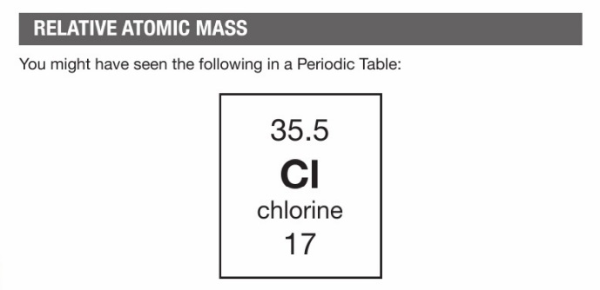

Slide 27
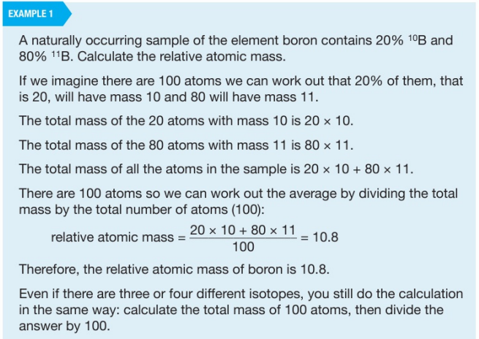

Slide 28
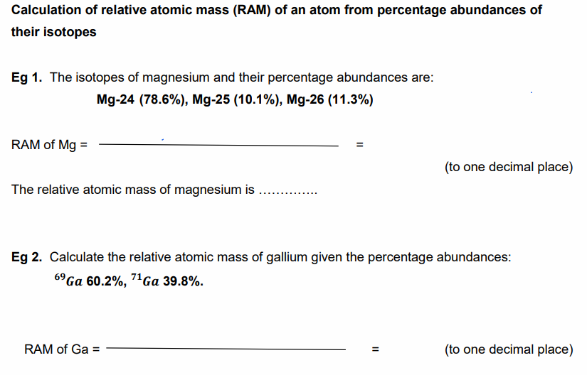

Slide 29
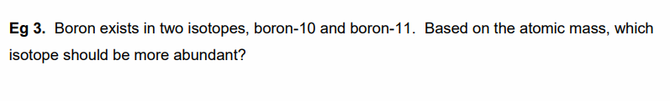

Slide 30
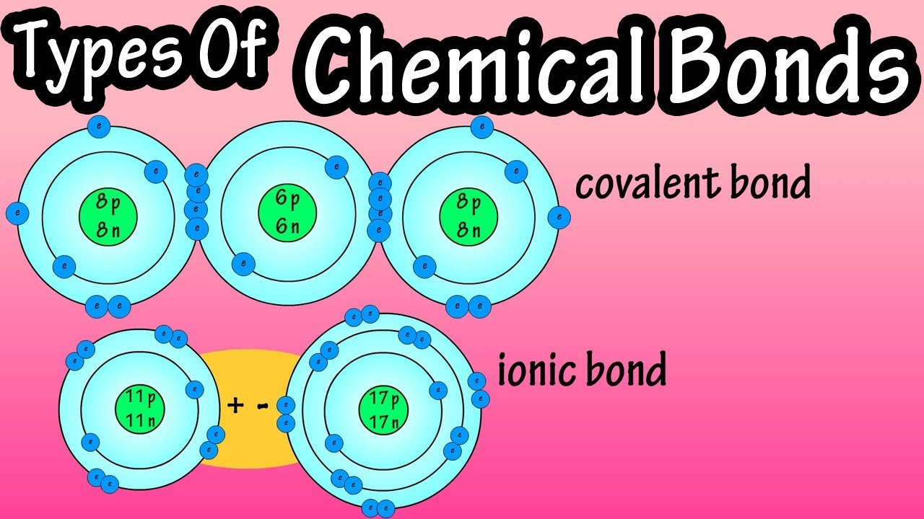
Structure and bounding
Aim of bonding between atoms is to achieve the nobel gas’ configuration.
Types of bonding
Ionic bond (metal atom and non-metal atom)
Covalent bond (non-metal atom and non-metal atom)
metallic bond (metal atom and metal atom )

Slide 31
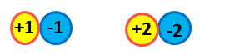
Ionic bonding(electrovalent bond)
How ionic bond is formed?
Ionic bonds are formed when electrons are completely transferred from metal to non-metal to produce ions with stable structure. These oppositely charged ions are held together by strong electrostatic force of attraction called ionic bond.
What is ionic bond?
An ionic bond is the strong electrostatic force of attraction between oppositely charged ions.
The ………….the number of charges of ions in the compound, the ………..the electrostatic attraction between oppositely charged ions.
The strength of ionic bonds – NaCl < MgO < AlN

Slide 32

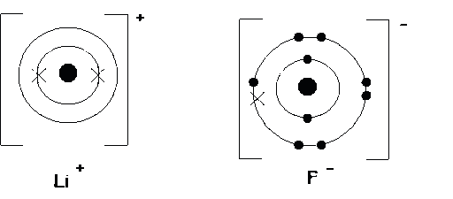
Ionic bonding in lithium fluoride
Explain in term of words.
Lithium atom loses one valent electron to become lithium ions with stable electronic structure. (Li+)
Fluorine atoms gain one valent electron from lithium atoms to becomes negative ions with stable electronic structure. (F-)
These oppositely charged ions are held together by electrostatic force of attractions known as ionic bond.
Li(2.1) Li+ (2)
F(2.7) F- (2.8)
Electron dot-cross diagram

Slide 33
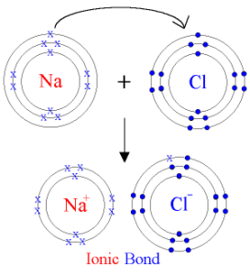
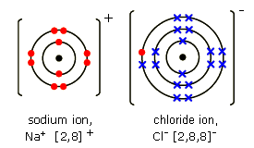
Some ionic compound diagrams
Sodium chloride (NaCl)

Slide 34
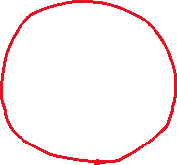
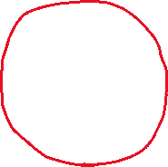









Slide 35
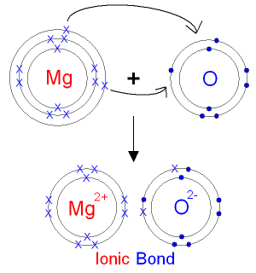
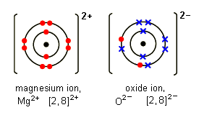
Magnesium oxide (MgO)

Slide 36











Slide 37











Slide 38
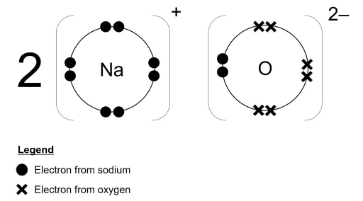
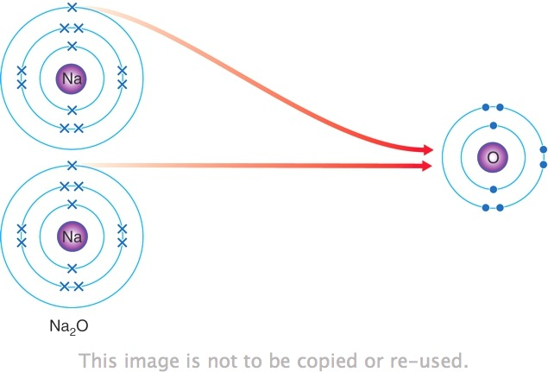
Sodium oxide(Na2O)

Slide 39










Slide 40










Slide 41
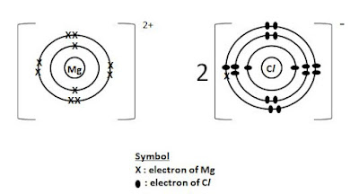
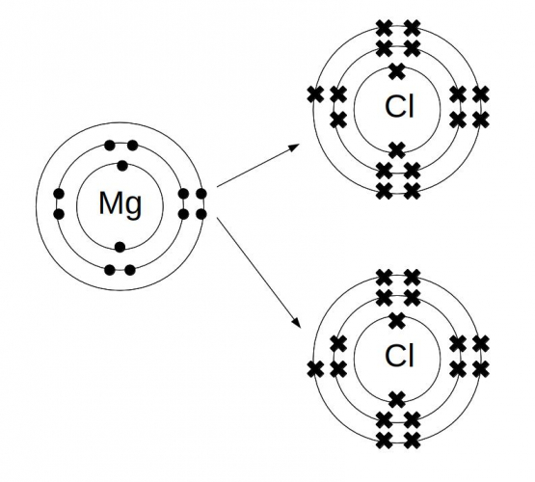
Magnesium chloride (MgCl2)

Slide 42
Lets draw some ionic compound
Aluminium chloride
Aluminium oxide
Potassium nitride
Sodium sulfide

Slide 43










Slide 44











Slide 45
Covalent compound
How covalent bond is formed?
A covalent bond is formed by the sharing of a pair of electrons between two atoms, to achieve stable structure. Positively charged nuclei is attracted to sharing electrons pair.
What is covalent bond?
A covalent bond is strong force of attraction between positively charged nuclei and a pair of sharing electrons.
If two atoms share,
(i) Sharing two valence electrons, single covalent bond is formed. (eg. Cl2)
(ii) Sharing four valence electrons, double covalent bond is formed. (eg. O2 and CO2)
(iii) Sharing six valent electrons, triple bond is formed.(eg. N2 and C2H2)
The greater the number of covalent bonds in a molecule, the stronger the bond.
covalent bond strength - Cl2 < O2 < N2

Slide 46

Covalent structure drawing
E dot-cross
Bond length

Slide 47





Dots and crosses diagram (using valency electron only)
Bonding electrons =
Non bonding electrons =

Slide 48


Bonding electrons =
Non bonding electrons =

Slide 49





Water molecules

Slide 50



Ammonia molecule (NH3)

Slide 51




Methane molecules (CH4)

Slide 52



Slide 53


Ethene molecules (C2H4)

Slide 54


Intermolecular forces and intramolecular forces
These forces of attraction between separate molecules are called weak intermolecular forces or weak Vander Waals forces.
They are a lot weaker than covalent or ionic bonds (intramolecular forces).
In melting, some intermolecular forces are broken.
In boiling, all intermolecular forces are broken and the molecules become free to move around as a gas.
Therefore, melting or boiling breaks ……………………… (not covalent bonds).

Slide 55

Except ethanol , NH3 & HCl

Slide 56


Slide 57
Compound & mixtures
 | Compound | mixture
components | Different elements are chemically joined in fixed mass proportion. | Different substances(elements or compounds) are mixed in any mass proportion.
property | Different from elements. | Same as elements.
Separation | Chemical methods (electrolysis) | Physical methods (filtration)

Slide 58
Differences between metal and non-metal
Physical properties
 | metal | Non-metal
Appearance | Shiny | Dull
Bpt & Mpt | High | Low
Conduction (heat and electricity) | Good | Poor (except graphite)
Density | Hard & high(except Na &K) | Low(except diamond)
Shape | Malleable & ductile | Brittle (carbon fibers can be ductile)
Sound | Sonorous (make pleasant sound) | Non-sonorous
state | Most are solids (Hg and Ga - liquids) | Most are gases. (C,S,P,I – solids & Br2-Liquid).

Slide 59
Chemical properties
metal | Non-metal
Form cations (lose valent electrons) | Form anions (gain valent electrons)
Form basic oxide(which will react with acid to form salt and water) | Form acidic oxide(which will react with bases to form salt and water)
React with water and acid | Do not react with water and acid

Slide 60


Slide 61


Slide 62


Slide 63
Giant Ionic crystal lattice

Slide 64

Structure of ionic compounds
In ionic compound, the oppositely charged ions are held together by the strong electrostatic forces of attraction called ionic bond.
Since the ions are arranged regularly, all ionic solid are giant crystalline ionic solids.

Slide 65



Sodium chloride ionic structure
monolayer of NaCl crystal
In sodium chloride crystal, each sodium ions is bonded by six chloride ions and each chloride ions is bonded by six sodium ions by strong electrostatic force of attraction to form giant ionic crystal lattice.

Slide 66
Property | Reasons
High melting point and boiling point . | The ions are held together by very strong electrostatic forces which need much energy to break down. CaO is more difficult to break down than NaCl.
Do not conduct electricity in solid state. | In solid, the ions are held together by strong electrostatic attractions and can only vibrate about a fixed point. They cannot move freely to conduct electricity.
Conduct electricity in molten or aqueous state. | In these state, ions are free to move to conduct electricity.
Soluble in water. | The water molecules can attract the ions away from the lattice. The ions can then move freely, surrounded by water molecules. (except MgO)
Low volatitily
Crystalline solid at room temperature

Slide 67
Giant covalent structures

Slide 68


Allotropes
Atoms of the same elements with different structure and different physical properties but in the same physical state.

Slide 69




1.Diamond
In diamonds, each carbon atom is covalently bonded with other four carbon atoms to form a giant 3D tetrahedral lattice.
(lattice means atoms are arranged regularly)
Uses – jewellery , tips of drills and cutting tools…

Slide 70
Properties of diamonds:
Property | reasons
High melting point and boiling point . | The carbon atoms are held together by strong covalent bonds which need much energy to break down.
Do not conduct electricity | Each carbon atom uses all its four valence electrons for bonding. Hence it has no delocalised electrons to conduct electricity.
Hard and rigid | All carbon atoms are bonded together by very strong covalent bonds in a giant molecular structure. The carbon atoms are not able to slide over each other

Slide 71

2.Graphite

Slide 72




Graphite has a hexagonal layer structure consisting of millions of layers of carbon atoms.
In graphites, each carbon atom is covalently bonded by the other three carbon atoms to form giant 2D hexagonal layer lattice.
Since carbon has four valent electrons , one valent electrons are left in bonding.

Slide 73

Uses – in pencils , inert electrode in electrolysis , as dry lubricant.

Slide 74
Properties of graphite:
Properties | Reasons
Soft and slippy | The weak Vander Waals’ forces of attraction between layers are easily overcome and this enables the layers to slide over each other.
High melting point and boiling point | A lot of energy is required to break the billions of strong covalent bonds between the carbon atoms.
Conduct electricity | Each carbon atom uses only 3 out of its 4 valence electrons for bonding. Hence, it has one delocalised electron to conduct electricity parallel to the layers.

Slide 75
Different properties between diamond and graphite
property | Diamond | Graphite
Appearance | Shiny and transparent | Black and opaque
Bpt and Mpt | High | High
Conduct electricity | No | Yes
Density | High | High
 | Hard and rigid | Soft and slippery

Slide 76


Slide 77


Slide 78


Metallic bonding
Metals are ……………………………… elements. So, metals have a tendency to ………….. their outermost electrons in order to achieve a ……………………… configuration.
As the atoms are closely packed together, the outermost valence electrons become free to
move throughout the whole structure. These electrons are ………………………………………
to form a sea of electrons.
A metallic bonding is the strong electrostatic force of attraction between the positive metal ions and delocalized electrons.

Slide 79


The structure of a metal

Slide 80


Numerous number of metal ions are regularly arranged in the sea of electrons to form the giant metallic lattice . The ions and delocalized electrons are held together by the strong electrostatic force of attraction called metallic bond.

Slide 81
Property | reasons
High Bpt and Mpt | Very strong electrostatic force of attraction between metal ions and delocalized electrons and so it need much energy to break down.
Good heat conductor | the heat energy can be transferred from one ion to the next by vibration, as they are so close together.
Good electrical conductor | They have mobile delocalized electrons to carry electricity. They move throughout the structure.
Malleable and ductile | Metal atoms are orderly packed in layers. The layers of atoms can easily slide over each other without breaking metallic bond when a force is applied.

Slide 82



Slide 83












